Slide 1
Welcome Educators!
Thank you for joining in advancing Métis education by raising the Métis Flag in your school. Raising the Métis flag in your educational community is a critical part of supporting all learners in their understanding about their histories and the complex relationships in their community.
Materials required:
Métis Flag (Contact Cree Productions at the Métis Nation of Alberta for ordering information. Flags range from very cheap ($10) to heavy duty (over $100))
The 'Flying the Métis Flag' presentation slides and printables
A connection to a Métis Knowledge Keeper or Elder and a plan to practice honoring relationality (a gift and honorarium). Contact education@rupertsland.org for more support
A speaker and access to internet to play the Métis Nation Anthem
Notes: It is recommended that speakers review the notes prior to presenting to facilitate best engagement. Resource content may NOT be adapted out of its original context. Ensure that Rupertsland Institute is cited as the source. Please reach out to the Education Team at education@rupertsland.org for more support.
education@rupertsland.org
Notes:
Key notes:
This is the title slide for educators. Reach out to RLI at anytime for support with the presentation: education@rupertsland.org
LINKS FOR PRESENTATION:
Links doc (shareable): https://docs.google.com/document/d/13Do38soN7GqG2Zt22GtIpTjPQU6gnMYGDFjBGL8N25s/edit?usp=sharing
Norma Spicer Opening Prayer Script:
https://drive.google.com/file/d/1ML6jvu5ulrozVzWEMHTs1PFw-RWlKnso/view?usp=sharing
Norma Spicer Opening Prayer Video: https://www.canva.com/design/DAE-jg4cPCc/edit
Who are the Métis Video:
https://www.youtube.com/watch?v=YvulIRnPE3Y&lc=UgzjklFXWdYd_Hgjnzl4AaABAg.9_u5RTam9J29a0Pd9x11GI
Who are the Métis Worksheets: https://drive.google.com/drive/folders/1YnZC2PeZuxRT2OrZszdw5JRKbeOZQcu-?usp=sharing
Flying the Métis Flag classroom printable: https://drive.google.com/file/d/14sF4lOGRIcj1AeRE9dNQXp8LFd5uTGo6/view?usp=sharing

Slide 2
RUPERTSLAND INSTITUTE PRESENTS
FLYING THE MÉTIS FLAG
education@rupertsland.org
Notes:
Taanishi (tahn-shee, Michif)
Tân'si (tahn-sih, Cree)
Hello and welcome to Flying the Métis Flag, as created by Rupertsland Institute.
PRESENTER:
Introduce yourself; your name, where you are from, your relationship to the Métis Nation, and why you care about this topic.
Introduce RLI:
Rupertsland Institute (first logo) is an affiliate of the Métis Nation of Alberta (second logo). RLI holds the mandate for Métis education, as given by leaders of the Métis Nation and Métis citizens. Rupertsland Centre for Teaching and Learning develops comprehensive foundational knowledge resources, engaging lesson plans, meaningful professional development opportunities and authentic classroom learning tools that speak accurately and meaningfully to topics in Métis education. As well as being mandated to advance Métis education, RLI is guided by leading Métis educators in the Alberta Métis Education Council (third logo).

Slide 3
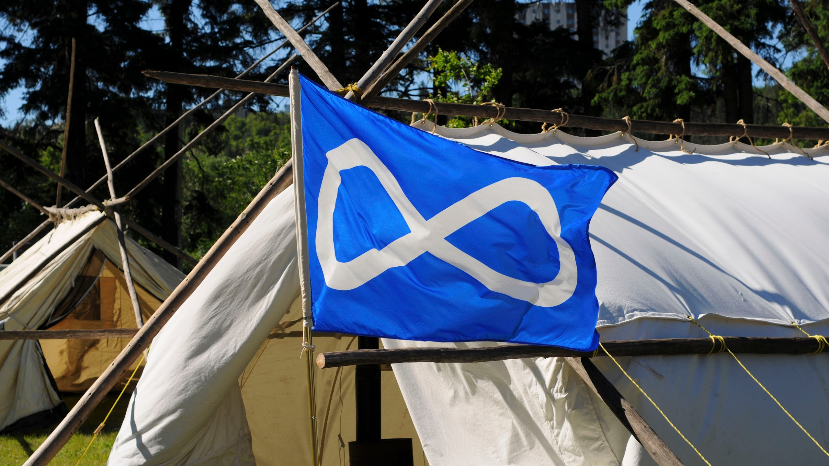
welcome - tawâw - miyoonakishkatoohk
Beginning
in a Good Way
(c) Rupertsland Institute 2022
Notes:
USE THIS SLIDE IF MÉTIS KNOWLEDGE KEEPER/ELDER IS AVAILABLE TO PRAY
PRESENTER:
The Métis Nation of Alberta recommends that you invite a Métis knowledge keeper or Elder to open the gathering in prayer if possible. At this time, introduce them and allow them to lead the prayer. As an alternative option, beginning in a good way can also include setting a collective intention. Guidance for this can be found in the notes below.
MICHIF:
tawâw [say: ta-wahw]
miyoonakishkatoohk [say: mih-yoo-na-gish-ga-toohk]
We would like to begin our presentation today in a good way. The Métis Nation of Alberta recommends that we invite a Métis knowledge keeper or Elder to open the gathering in prayer if possible.
To introduce an Elder or Knowledge Keeper:
Let us welcome __________.
They are a Métis [knowledge keeper or elder] who has kindly agreed to join us and open our gathering today in prayer. Thank you, maarsii (mar-see) for leading us.
Allow Métis knowledge keeper or elder to speak.
ALTERNATIVE OPTION - COLLECTIVE INTENTION
PRESENTER: Please edit this prior to presenting to best suit your dedication for experiencing this presentation.
Today we would like to begin by setting a collective intention together. We would like to work together to build positive relationships between our school/community and the Indigenous communities that we are connected to. Together we are here to open our hearts and minds to hear from the Métis Nation about their true history and story.

Slide 4
welcome - tawâw - miyoonakishkatoohk
Beginning
in a Good Way
An Opening Prayer with
Métis Knowledge Keeper Norma Spicer
(c) Rupertsland Institute 2022
Notes:
LINK TO PRAYER:
https://drive.google.com/file/d/1ML6jvu5ulrozVzWEMHTs1PFw-RWlKnso/view?usp=sharing
USE THIS SLIDE IF MÉTIS KNOWLEDGE KEEPER/ELDER IS NOT AVAILABLE TO PRAY
PRESENTER:
The Métis Nation of Alberta recommends that you invite a Métis knowledge keeper or Elder to open the gathering in prayer if possible. If a Métis Knowledge Keeper or Elder is not available, open the session in prayer led by a member in your community, by joining with the prayer provided by Métis Knowledge Keeper Norma Spicer (click on the blue speaker icon),
or by setting a collective intention to work together to share truth and foster reconciliation in your community relationships.
MICHIF:
tawâw [say: ta-wahw]
miyoonakishkatoohk [say: mih-yoo-na-gish-ga-toohk]
We would like to begin our presentation today in a good way. The Métis Nation of Alberta recommends that we invite a Métis knowledge keeper or Elder to open the gathering in prayer if possible.
To introduce Norma Spicer:
Let us take a moment to join in prayer as led in a recording by Métis Knowledge Keeper Norma Spicer.

Slide 5
Housekeeping
Symbols to Watch for
Mute
Chat Box
Recording
Type in the chat
Please mute your microphone and disable video unless you are speaking
Type your questions into the chat box; these will be answered at the end of the PD
Please know that we are recording this event
Check a worksheet
Ask a question
Discuss with a group
(c) Rupertsland Institute 2022
Notes:
If gathering online, these housekeeping instructions will guide your time together. Feel free to skip this slide or share alternate instructions about how people should engage with the presentation that better suit your situation.
If online, let folks know that they are welcome to write notes or questions in the chat, and that there will be opportunities to engage with questions throughout the presentation.
Point out the SYMBOLS TO WATCH FOR - these will signal a response required from learners

Slide 6
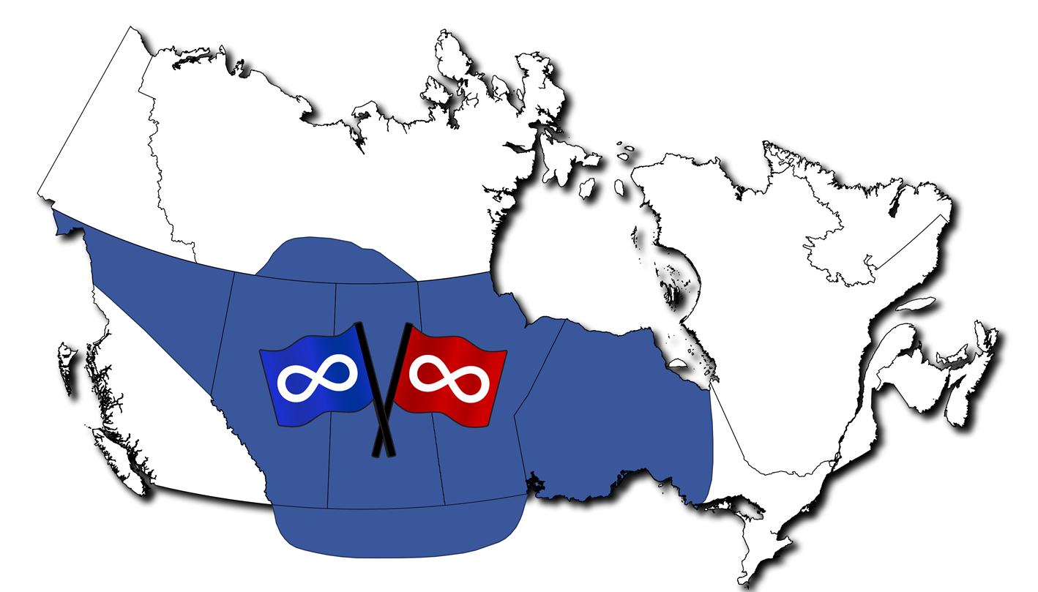
Acknowledging the
Traditional Homeland of the Métis Nation
Do you know which Métis Nation of Alberta Region you are in?
(c) Rupertsland Institute 2022
Notes:
A key part of beginning in a good way include acknowledging the lands and Nations that we are connected to.
PRESENTER: Today I am joining from Métis Nation of Alberta Region [?] and Treaty territory [?].
Rupertsland Institute acknowledges Treaty 4, 6, 7, 8 and 10 territories within Alberta and the traditional Métis Homeland. We acknowledge the many First Nations, Métis and Inuit whose footsteps have marked these lands for generations, including the many places that you are joining from. We are grateful for the traditional Knowledge Holders and Elders who are still with us today and those who have gone before us.
The Métis Nation are an Indigenous people. They were born as a people and developed as a Nation along the fur trade routes that wove the three prairie provinces—Manitoba, Saskatchewan, and Alberta—together with parts of Ontario, British Columbia, the Northwest Territories, and the Northern United States. This is the Métis Nation Homeland. They are Otipemisiwak—the free people, the people who own, govern, and care for themselves.
We recognize the land as an act of reconciliation and gratitude to those whose territory we reside on or are visiting.

Slide 7
Learn about the
Métis Nation
and the Métis Flag
GOALS
FOR TODAY...
Understand the
importance of raising
the Métis Flag
Be confident about
raising the Métis Flag
for everyone
(c) Rupertsland Institute 2022
Notes:
Today we will learn about the Métis Nation and the Métis flag. We will reflect together about the importance of raising the Métis flag, and then together we will raise the Métis flag for our community.

Slide 8
MÉTIS ARE AN INDIGENOUS NATION, THEY ARE...
People who self-identify as Métis
People who are distinct from other Aboriginal peoples
People who are have a historic connection to the Métis Nation and who are accepted by the Métis Nation
Who are the Métis?
Listen carefully...
The Métis Nation knows themselves through
__ __ __ __ __ __.
(c) Rupertsland Institute 2022
Notes:
This is the national definition of Métis, as established by the Métis Nation across the Homeland.
Métis does not simply mean 'mixed blood.' Unfortunately, many people were wrongly taught that, if someone doesn’t have enough First Nations blood to be on the Indian Registry, that person must be Métis. This is just one misinformed teaching about Métis identity.
Métis citizens define themselves as “a person who self-identifies as Metis, is distinct from other Aboriginal peoples, is of historic Metis Nation ancestry, and is accepted by the Metis Nation.”
Let's watch this video together to reflect on how these Métis leaders describe the Métis Nation. Do all Métis think and look the same? This will be important when we look at stories around the meaning behind the Métis flag.
WORKSHEET -
There are 3 levels of worksheet you can access for the learners you're engaging with, please fill one out as we watch this video.
LINK: https://drive.google.com/drive/folders/1YnZC2PeZuxRT2OrZszdw5JRKbeOZQcu-?usp=sharing
Who are the Métis video: https://www.youtube.com/watch?v=YvulIRnPE3Y
ANSWER:
FAMILY

Slide 9
Métis Nationhood
Métis Ethnogenesis (1700s)
Generations of children of First Nations people and
Euro-Canadian people established Métis communities, with their own values, culture, traditions, languages, governance, and worldviews.
By the early 1800s, these communities formed their distinct nationhood, becoming the (_ _ _ _ _ _ _ _ _ _),
an Indigenous people who knew the land and governed themselves.
HINT:
_ é _ _ _
_ a _ _ _
(c) Rupertsland Institute 2022
Notes:
Break down this word ethnogenesis:
ethno - ethnicity
genesis - beginnings
As just explored, Métis are not a mixed half-and-half people... They are a whole, distinct people who have multiple ancestors. They have their own distinct culture and language.
Read this quote from Homeland History: Métis Foundational Knowledge Theme:
“Through the process called “ethnogenesis,” the generations of children of First Nations people and Euro-Canadian people developed a distinct culture, language, and way of being. By the late 1700s, these families established Métis communities, with their own values, culture, traditions, languages, governance, and worldviews. By the early 1800s, these communities formed their distinct nationhood, becoming the Métis Nation, an Indigenous people who knew the land and governed themselves.”
Homeland History: Métis Foundational Knowledge Themes, Rupertsland Institute, November 15, 2021.
Answer: Métis Nation

Slide 10
Métis Nationhood
A Resilient History (1800s)
On June 9, 1816, the Victory of Frog Plain was the first time the Métis gathered and fought for their rights as a Nation under the infinity flag. This event is also known as the Battle of Seven Oaks.
They celebrated their culture and traditions, lived out entrepeneurial lives in the fur trade, and gathered for the Buffalo Hunt throughout this century.
In the late 1800s, Métis resisted Canada's imposing control over their family homes and lands in the Red River Resistance and the North-West Resistance.
The Canadian flag was first flown in 1965, whereas the Métis Nation flag was first flown in 1815.
How many years BEFORE the Canadian flag was the Métis Nation flag flown?
(c) Rupertsland Institute 2022
Notes:
Read information on the slide.
Question in the chat:
The Canadian flag was first flown in 1965, whereas the Métis Nation flag was first flown in 1815.
How many years BEFORE the Canadian flag was the Métis Nation flag flown?
Answer:
The Métis Nation flew their flag 150 years before Canada adopted their official flag.
Tip: This is important to consider when setting up the flags in our communities!

Slide 11
Check your understanding!
True or False? Do you know the true answer?
1.
A student is Métis if they have at least one First Nations parent.
2.
Ethnogenesis means the beginning of a culture.
3.
Métis communities had their own distinct language, culture and identity by the late 1700s.
4.
The Métis Nation flew their flag first in 1815.
5.
Métis rebelled against Canada in the late 1800s.
(c) Rupertsland Institute 2022
Notes:
Check your understanding!
True or False? If false... Do you know the true answer?
Options to Engage:
Thumbs up/down
Stand up/down
Move to each side of the room
Stand on left/right foot
Online Option: Chat Waterfall
In the chat, type your answer to each question BUT do not hit 'submit' until I say go!
I'll give you 1 minute to type true, false, and any correct answer.
Okay, now that you've had time to brainstorm... Hit submit! Let's see what everyone thinks.
1. False
A student is Métis if their family 1) identifies as Métis, 2) legally does not self-identify as First Nations or Inuit, 3) has a historic connection to the Métis Nation and is accepted by a Métis Nation today.
If a student has both Métis and First Nations relatives, legally they can only declare their relationship with one Nation.
2. True
3. True
4. True
5. False
The Métis Nation has been a distinct, self-governing Nation since the early 1800s, prior to Canada becoming a Nation. In the late 1800s, they did not rebel against their own government, they RESISTED colonial imposition of the Canadian government.

Slide 12
“There were two societies who treated
[existed] together.
One was small, but in its
smallness had its rights. The other was
great, but in its greatness
had no greater
rights than
the rights of the small.”
The Métis Nation has always advocated for a
Nation to Nation
relationship with Canada.
Louis Riel
(c) Rupertsland Institute 2022
Notes:
From its very beginnings and still today, the Métis Nation has always advocated for a respectful nation-to-nation relationship with Canada.
Reflect on this quote from Louis Riel, Métis leader, as he speaks about the historical realities about the Métis Nation and Canada. Read his quote aloud.

Slide 13
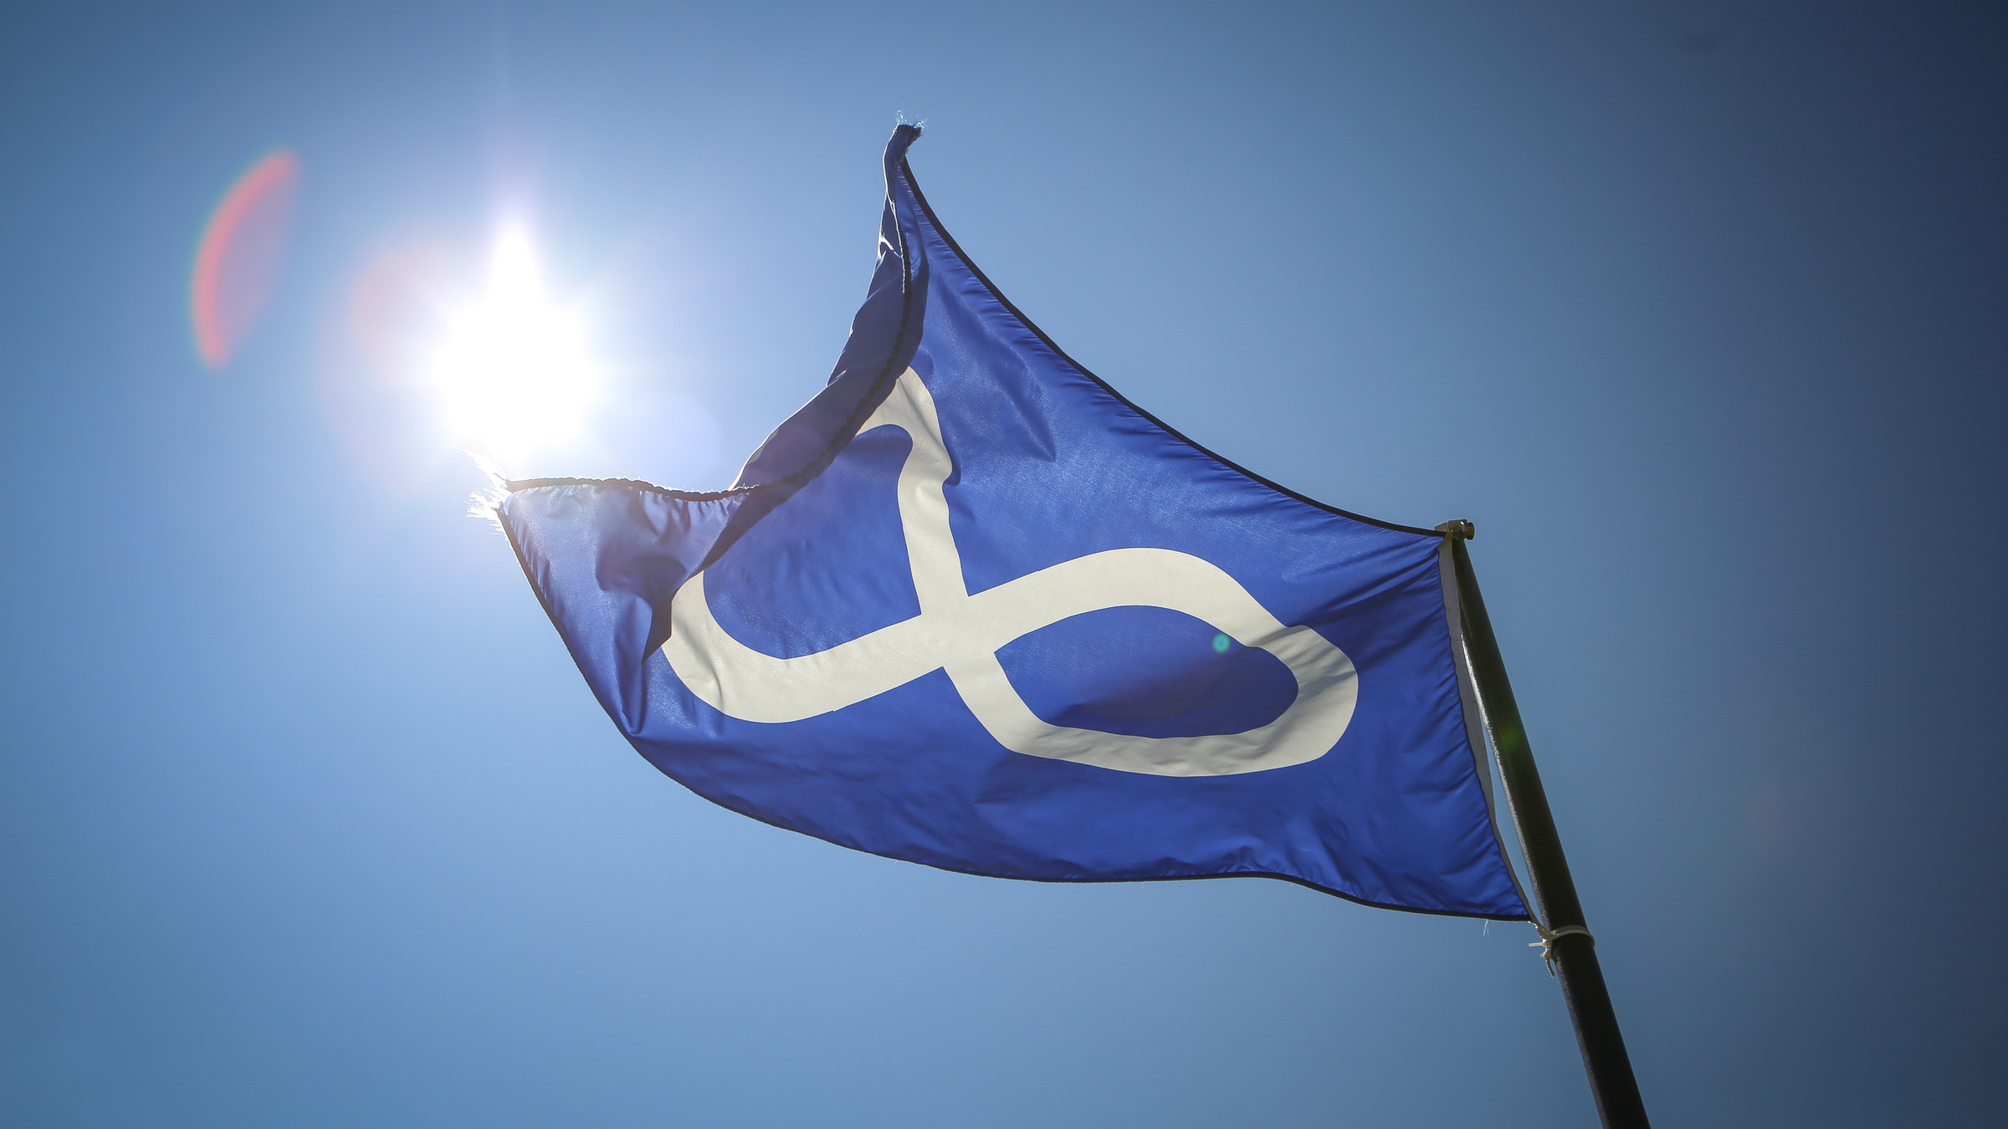
The Métis Nation flag is a symbol of
Métis nationhood
and unity.
It is a reminder of what their ancestors fought for,
to preserve their way of life, their culture, and their traditions.
(c) Rupertsland Institute 2022
Notes:
The Métis Nation flag is a symbol of Métis nationhood and unity. It is a reminder of what the ancestors of the Métis Nation fought for to preserve their way of life, their culture, and their traditions.

Slide 14
About the
Métis Nation Flag
Symbols and Colours
The infinity symbol in the centre represents the joining of two cultures and the immortality of the Métis Nation.
Today, the Métis recognize both red and blue versions of their flag as a symbol of their nationhood.
Should you fly a blue or red Métis Nation flag in your community?
(c) Rupertsland Institute 2022
Notes:
The infinity symbol in the center represents the joining of two cultures and the immortality of the Métis Nation. Today, the Métis recognize both red and blue versions of their flag as a symbol of their nationhood.
Question:
Should you fly a blue or red flag Métis Nation flag in your community?
Answer:
Contact local Métis leaders in your area to see what color they fly! RLI suggests you contact the Métis Nation Regional Office and/or Métis Locals in your area. If you are near a Metis Settlement, you could also contact them.
In the chat, share who you think you could contact. Which Regional Office should you contact? https://albertametis.com/governance/mna-regions/

Slide 15
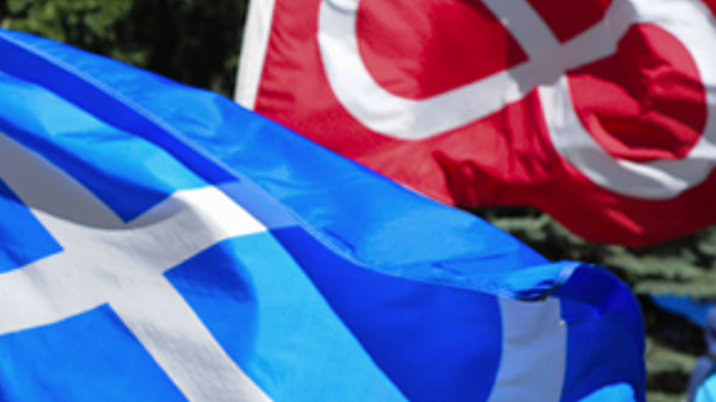
Why fly the Métis flag?
(c) Rupertsland Institute 2022
Notes:
Why is it important to fly the Métis Nation flag in your school?
Let's begin with a reflection about the importance of flying any flag, then we will head to breakout sessions to discuss why we think we should fly the Métis flag.

Slide 16
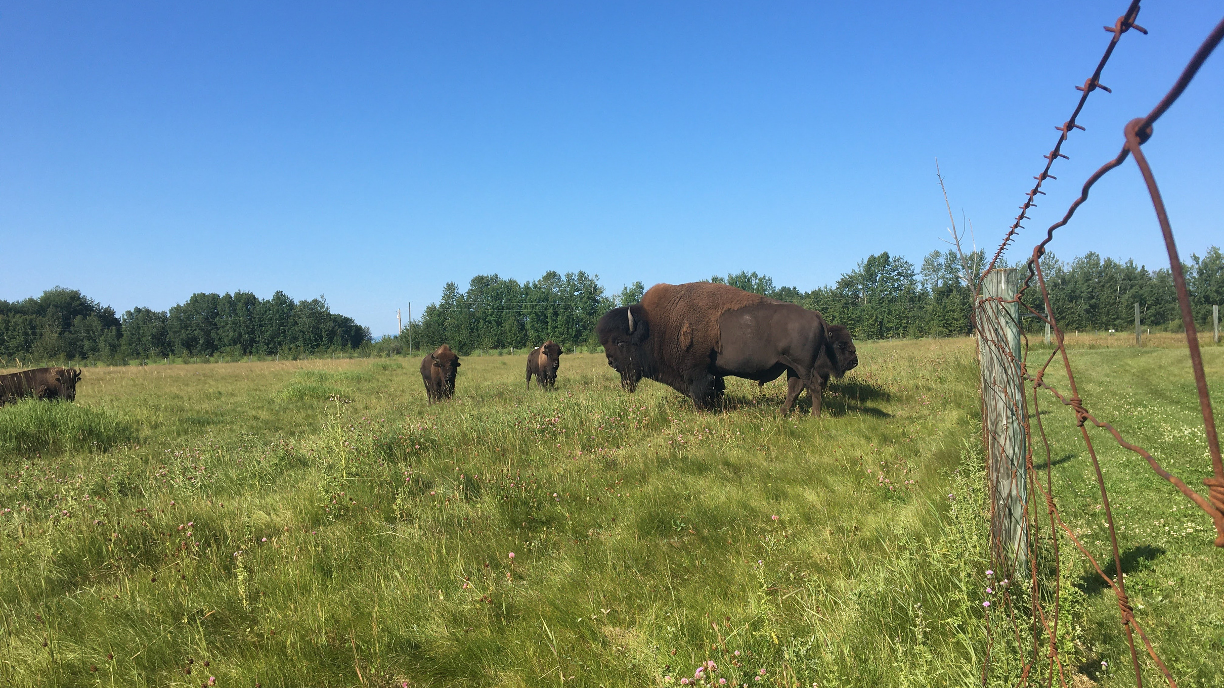
mâmitonihtamohkan... reflect...
Question 1:
Where have you seen the Canadian flag flying?
Question 2:
When was the Canadian flag first flown?
Question 3:
How do you feel when you see the Canadian flag flying?
(c) Rupertsland Institute 2022
Notes:
mâmitonihtamohkan - you reflect on it (Northern Michif)
[say: maa-mih-toh-nih-tah-moh-kawn]
When considering when, where and why we fly flags, let's consider a flag we are all familiar with: the Canadian flag.
In the chat, let's brainstorm our answers to these questions.
Q1 - Where have you seen the Canadian flag flying?
Suggested answers: schools, political buildings, parades, shopping centres, etc.
Q2 - When?
The Canadian flag that unifies the country today was first flown in 1965.
Q3 - How do you feel when you see the Canadian flag flying? What about when you see the flag in another country?

Slide 17
Why fly the Métis flag in your community?
Welcoming Students of All Backgrounds
Responding to TRC Calls to Action #63
Seeing the Métis Nation flag is a visual invitation to all students to be themselves and share of their unique identities.
Honoring the Métis Nation flag will build everyone's capacity for intercultural understanding, empathy, and mutual respect
Commemorating Métis Nationhood
Celebrating Métis Culture
Flying the Métis flag honors the historical relationship that all Canadians share with the Métis Nation.
Flying the Métis flag will invite Métis students to learn about their culture, foster a sense of belonging and encourage them to be proud of who they are.
(c) Rupertsland Institute 2022
Notes:
Here are four core reasons it’s important to fly the Métis flag in your community.
Invite folks to share a reason they think it’s important to raise the Métis flag.
PRESENTER: Please add your personal reflection as to why your school community has decided to start flying the Métis flag now.

Slide 18
HOW DO YOU FEEL WHEN YOU SEE THE MÉTIS FLAG FLYING?
Easton Tattrie, Grade 6 Métis Student​
"It's nice and fun to see. I want to tell people that don't know what it means."
Norma Spicer, Métis Knowledge Keeper​
"When I see our Infinity flag flying at events and ceremonies my heart fills with emotion and I feel myself rising in wonder and awe as a strong sense of belonging starts flooding my vison of the path once taken by those who’s steps, I now follow; how they fought for our Nation; their strength and resistance, our relations and kinship, and of our ways of living and being so generously gifted through generations making me so proud to be Métis." ​
Hearing from community...
(c) Rupertsland Institute 2022
Notes:
Reflect upon these quotes from a few Métis community members together.
Ask folks:
What do you think of when you see the Métis flag flying?
How do you feel when you see the Métis Nation flag flying?

Slide 19
Breakout Session:
Question 1:
Where have you seen the Métis flag flying?
Question 2:
Where could it be flown? What impact could that have?
Question 3:
Why fly the Métis flag in your community?
(c) Rupertsland Institute 2022
Notes:
Awesome, thank you for sharing your answers regarding the Canadian flag.
Now let's breakout into small groups for 5-10 minutes.
Break groups into chats of 2-3 people, dependent on group size to answer the three questions.
If virtual, post questions in the chat:
Where have you seen the Métis flag flying before?
Where could it be flown? What impact would that have?
Why fly the Métis flag in your community?

Slide 20
Raising the
Métis Flag
A MÉTIS NATION OF ALBERTA GUIDELINE
Gather where the Métis Flag will be raised
Invite the Métis Knowledge Keeper or Elder to open in prayer
Share a description about the Flag, and why it is being raised
Begin to play the Métis Nation Anthem for all to hear
Invite any Métis students, if any present, to begin raising the flag
(c) Rupertsland Institute 2022
Notes:
This is the guideline provided by the Métis Nation of Alberta about how to raise the Métis flag in your community. By engaging in this presentation together, you have prepared your community to take up these steps for the actual raising of the flag.

Slide 21
Proud to be Métis
The Métis Nation Anthem
Click on the image to open the anthem video and lyrics!
(c) Rupertsland Institute 2022
Notes:
Métis Nation Anthem (video and lyrics) - https://albertametis.com/culture/anthem/
At this link you can also download an .mp3 copy of the anthem for easy access.
PROUD TO BE MÉTIS
LYRICS BY CLINT BUEHLER MUSIC BY DENNIS CHARNEY
In the forest, on the river, and across the western plain, As the white man journeyed westward to the land of the Indian. A new race was created, a new nation rose up strong. Hardship as its destiny, and its curse to not belong.
In the land from which they came, in the land they helped to build. They found themselves the alien, found their vision unfulfilled. And despite their valiant effort to defend what they believe. When at last the battle ended, they were only left to grieve.
[Chorus]
We are proud to be Métis, watch our Nation rise again. Nevermore forgotten people, we’re the true Canadian.
From across the plain they travelled, from Red River to the Peace. Looking for their own homeland that would help them to replace, All the land that had been taken, and the dreams that had been dashed. Their brave heroes now called traitors, and courageous deeds now passed. But their spirit was not broken, and their dreams have never died.
Their determination strengthened, even while the people cried, As they waited for the battle that would end their years of pain, And the final bloodless battle, when the Nation rose again.
[Chorus]
We are proud to be Métis, watch our Nation rise again. Nevermore forgotten people, we’re the true Canadian.
For this newest generation and the future ones to come, With the past to motivate us, it will help to keep us strong. As we build the Métis Nation, as we watch it rise again, Our past loss is motivation, to inspire our future gain.
[Chorus]
We are proud to be Métis, watch our Nation rise again. Nevermore forgotten people, we’re the true Canadian. We are proud to be Métis, watch our Nation rise again. Nevermore forgotten people, we’re the true Canadian.

Slide 22
Frequently Asked Questions
How often should we commemorate/carry the Métis Nation and the flag?
Should a RED or BLUE Métis Nation flag be flown?
Communities are welcome to fly either flag! The blue Métis Nation flag is most commonly used across Métis communities in Alberta. Educational leaders are advised to seek guidance from the Métis leaders in their area in respect of their preference (such as Métis Locals, MNA Regional Offices, or Metis Settlement offices).
Fly and carry the Métis Nation flag at all gatherings. Consider - when do you fly the Canadian flag, and why?
Questions?
(c) Rupertsland Institute 2022

Slide 23
Frequently Asked Questions
Where can a
Métis Nation flag
be purchased?
What time of year should we raise the Métis Nation flag?
Flags can be purchased from Cree Productions, an affiliate of the Métis Nation of Alberta.
Raising the Métis Nation flag is a commemoration of Métis history, and a celebration of Métis identity, culture and presence in the community, so ANYTIME of the year is good. You may also consider hosting this event during Métis Week (the week of Nov 16) or National Indigenous Peoples Month (June).
Questions?
(c) Rupertsland Institute 2022

Slide 24
Frequently Asked Questions
In what order should we position the flags ?
Should we offer the Métis Elder or Knowledge Keeper protocol?
RLI advises that schools make an intentional practice in ordering the flags flown in their community. Some options worth considering include by date of establishment, or by order of the historical presence of the Nations in your area. Educators may also need to consider the policies of their organization.
Protocol traditionally refers to the offering of tobacco or other medicines as an act of honoring reciprocity towards elders, knowledge keepers and community members. RLI encourages educators to practice reciprocity (i.e. honorarium and a gift), however it is important to ask the Elder or Knowledge Keeper if they require protocol for the event.
Questions?
(c) Rupertsland Institute 2022

Slide 25
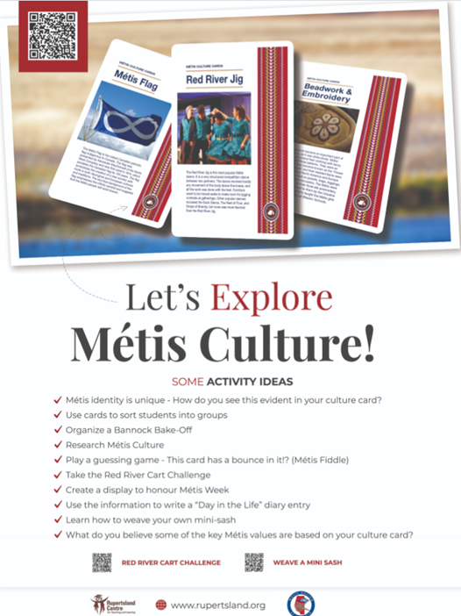
The Métis Flag is flying... NOW WHAT?
Continue LEARNING about the Métis Nation!
Register for the Rupertsland Education Community Connections Room (the RECC Room) to stay connected to resources for Métis and non-Métis students.
https://rli.connectedcommunity.org/home
Check out Rupertsland Institute for a variety of FREE resources to extend student learning about the Métis Nation.
https://www.rupertsland.org/teaching-learning/
Flying the Métis Flag Printable
Métis Culture Cards
Métis Digital Scavenger Hunt
Michif Activity and Design Booklet
and more!
(c) Rupertsland Institute 2022
Notes:
RLI has a variety of resources available to extend the reflection after the Flag has been raised. Access the many different activities, games, lesson plans and more to continue learning about the Métis Nation in your classroom.
RECC Room link:
https://rli.connectedcommunity.org/home
RLI Website:
https://www.rupertsland.org/teaching-learning/
WORKSHEET:
Flying the Métis Flag printable (NEW) https://docs.google.com/document/d/12GhhR78GNmF4QXoz8mlStiOWwDNXZ0Q1gewI00T1uSs/edit?usp=sharing

Slide 26
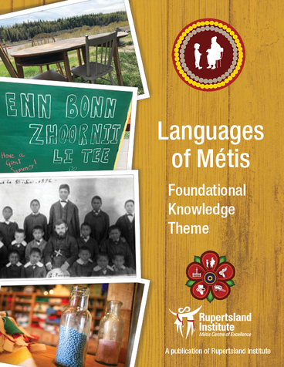
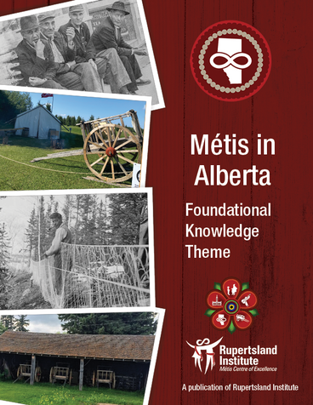
Read the
Métis Foundational Knowledge Themes
(FREE, online resources)
(c) Rupertsland Institute 2022
Notes:
In November 2021, Rupertsland Institute was proud to publish the Métis Foundational Knowledge Themes.
Métis educators, Nation leaders, and cultural experts collectively agreed on five themes to support educators as they develop their foundational knowledge about the Métis in Alberta.
Each theme shares information about Métis history, identity, and life in Alberta. Métis voices are authentically shared through the themes, woven together with academic research to best share our Métis story in Alberta.
These learning resources are available FREE online at rupertsland.org, under the 'Empowering Educators' tab on the K-12 webpage.
Link: https://www.rupertsland.org/teaching-learning/empowering-educators/

Slide 27
Register for the Métis Foundational Knowledge Themes Moodle Course
on Rupertsland Institute's website (FREE)
(c) Rupertsland Institute 2022
Notes:
The Métis Foundational Knowledge Moodle Course is based on the Foundational Knowledge Themes. It is our vision that by completing this FREE, ASYNCHRONOUS course, educators will be a part of transforming education in Alberta to include an understanding of Métis foundational knowledge, Métis content and Métis resources that ALL learners and educators can access in an authentic, purposeful way.
Please let the team know if you are interested in joining a monthly cohort through the form on the 'Empowering Educators' tab on the K-12 webpage
LINK FOR CHAT: https://forms.gle/j4FsTMYqdksShV8D9

Slide 28
FLYING THE MÉTIS FLAG
SHARE ON SOCIAL MEDIA TO BUILD AWARENESS ABOUT RAISING THE MÉTIS FLAG IN YOUR SCHOOL
TAG US!
@RUPERTSLAND CENTRE FOR TEACHING AND LEARNING
#RCTL
education@rupertsland.org
Notes:
RLI is always presenting more resources, be sure to stay connected to learn more!
Follow RCTL on Facebook, Instagram, Twitter and YouTube to keep updated on the latest events and resources that are always being released!
Feel free to reach out for any kind of questions or support anytime: education@rupertsland.org
Links from presentation are available here: https://docs.google.com/document/d/13Do38soN7GqG2Zt22GtIpTjPQU6gnMYGDFjBGL8N25s/edit?usp=sharing

