Slide 1

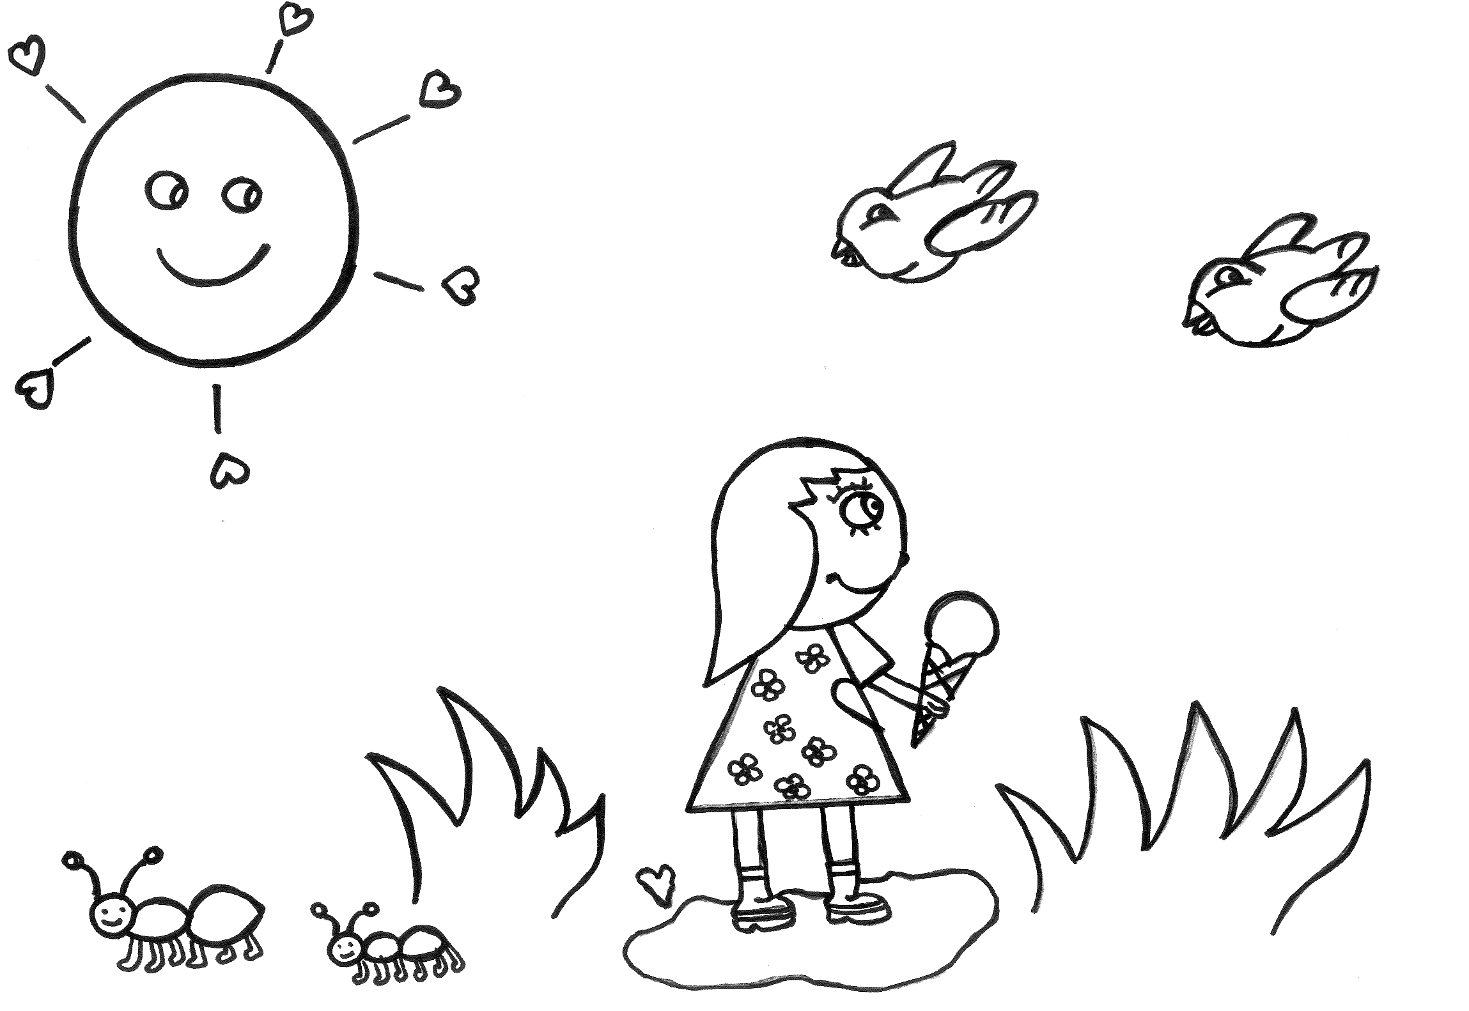

Copyright © Rupertsland Institute 2021

Slide 2

Please enjoy these colouring pages designed by Métis artisan Connie Kulhavy
and Rupertsland Institute’s K-12 Education Team
With gratitude to Michif language knowledge holder Mary SkyBlue Morin for sharing her traditional language, Northern Michif, to enhance Métis education
Thank you to Cheryl Devin, beginning Heritage Michif speaker, for her contribution
Print/Colour/Repeat
Download the Powerpoint and Use the DRAW tool in Powerpoint to colour in the pictures
Pronunciation is available in the speaker’s notes
Copyright © Rupertsland Institute 2021
Display or copying for classroom use is permitted by the rightsholder. To request permission to revise or adapt, please contact the rightsholder.
Notes:
In Heritage Michif, ‘zh’ make a sound like a soft ‘g’ sound, similar the ’g’ sound when you say ‘orange’

Slide 3

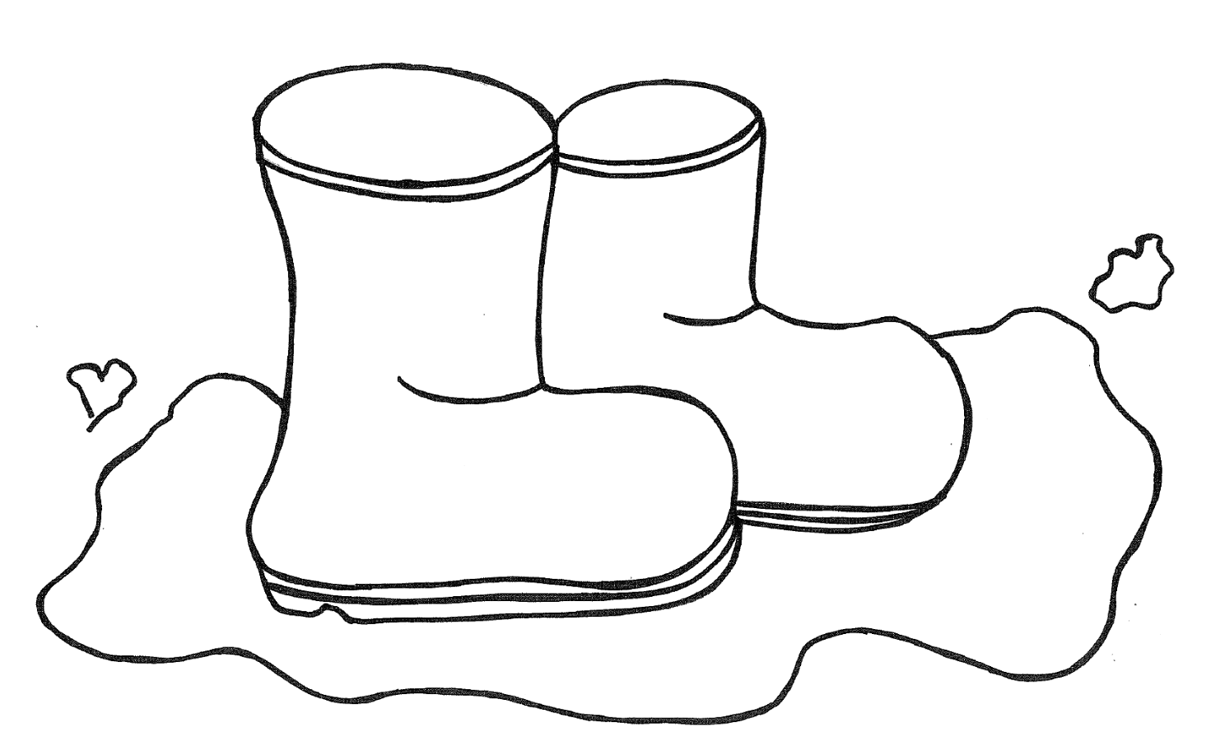
With gratitude to Michif language knowledge holder Mary SkyBlue Morin for sharing her traditional language to enhance Métis education.
Maarsii to Métis educator Cheryl Devin, beginning Michif speaker, for her Heritage Michif contribution.
Please enjoy these activity pages designed by Métis artisan Connie Kulhavy and Rupertsland Institute K-12 Education Team.
Cover design credit is to Métis graphic designer, Emma Grant.
Community guides all that we do with love.
Copyright © Rupertsland Institute 2021

Slide 4
Michif is the unique language of the Métis.
As a result of the oral, community-based development of this language, Michif is diverse and complex in its dialects and structure.
Northern Alberta Michif is known to have more of a Cree influence. While Heritage Michif is a blended language of both French nouns and Cree verbs. Both use language structure to communicate the unique culture and identity of Métis people.
When education supports the deep appreciation of Michif language in general, the learner develops a better understanding of Métis people. By demonstrating the relevance and importance of Indigenous languages, teachers will be better equipped to support their students, and to develop foundational knowledge in an education system that aligns with Métis families’ desires for our people. Validating the languages of Métis will help create pathways for students.
For more Métis Education resources:
Visit rupertsland.org
Email education@rupertsland.org
Copyright © Rupertsland Institute 2021

Slide 5
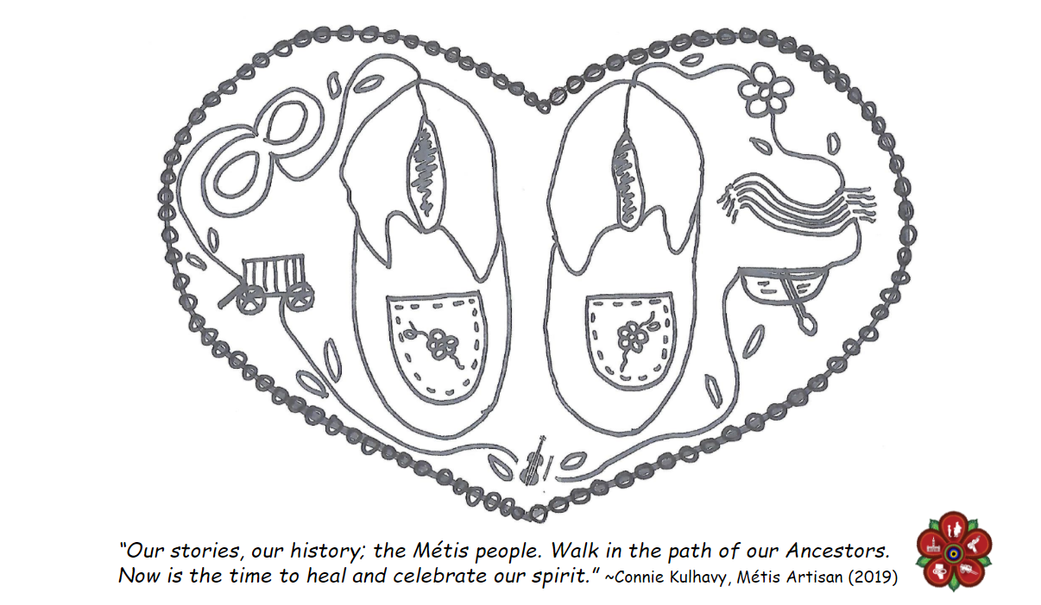
My name is Connie Kulhavy. I have worked in schools for over 20 years and I am also an Artist who loves sharing my Métis-Michif Culture. I was born in Hay River, NT. I have lived in Quebec City, Nanaimo and most recently Edmonton. All three languages, Michif, French, and English were spoken by my Grandmas and Grandpas, and so I was very happy to be asked to illustrate the pictures for this book.
Copyright © Rupertsland Institute 2021

Slide 6
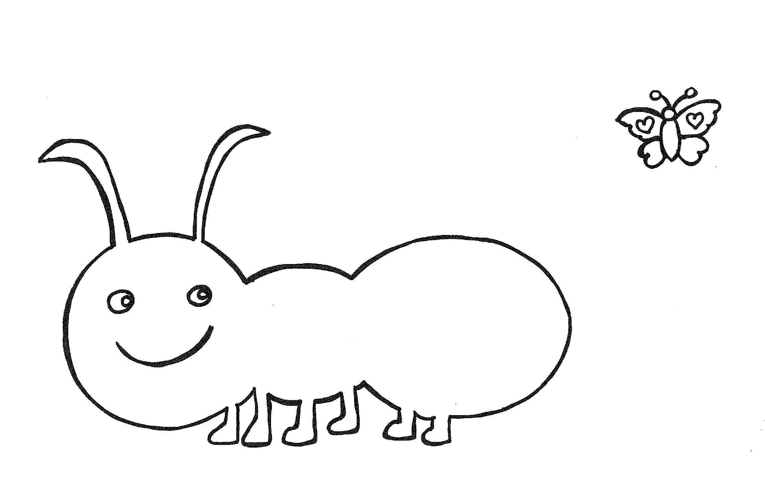
kâskitê wâw ________
nwayr ________
black ________
Copyright © Rupertsland Institute 2021
Notes:
kâskitê wâw (say: kah-ski-teh wahw)
nwayr (say: n-way-r)

Slide 7
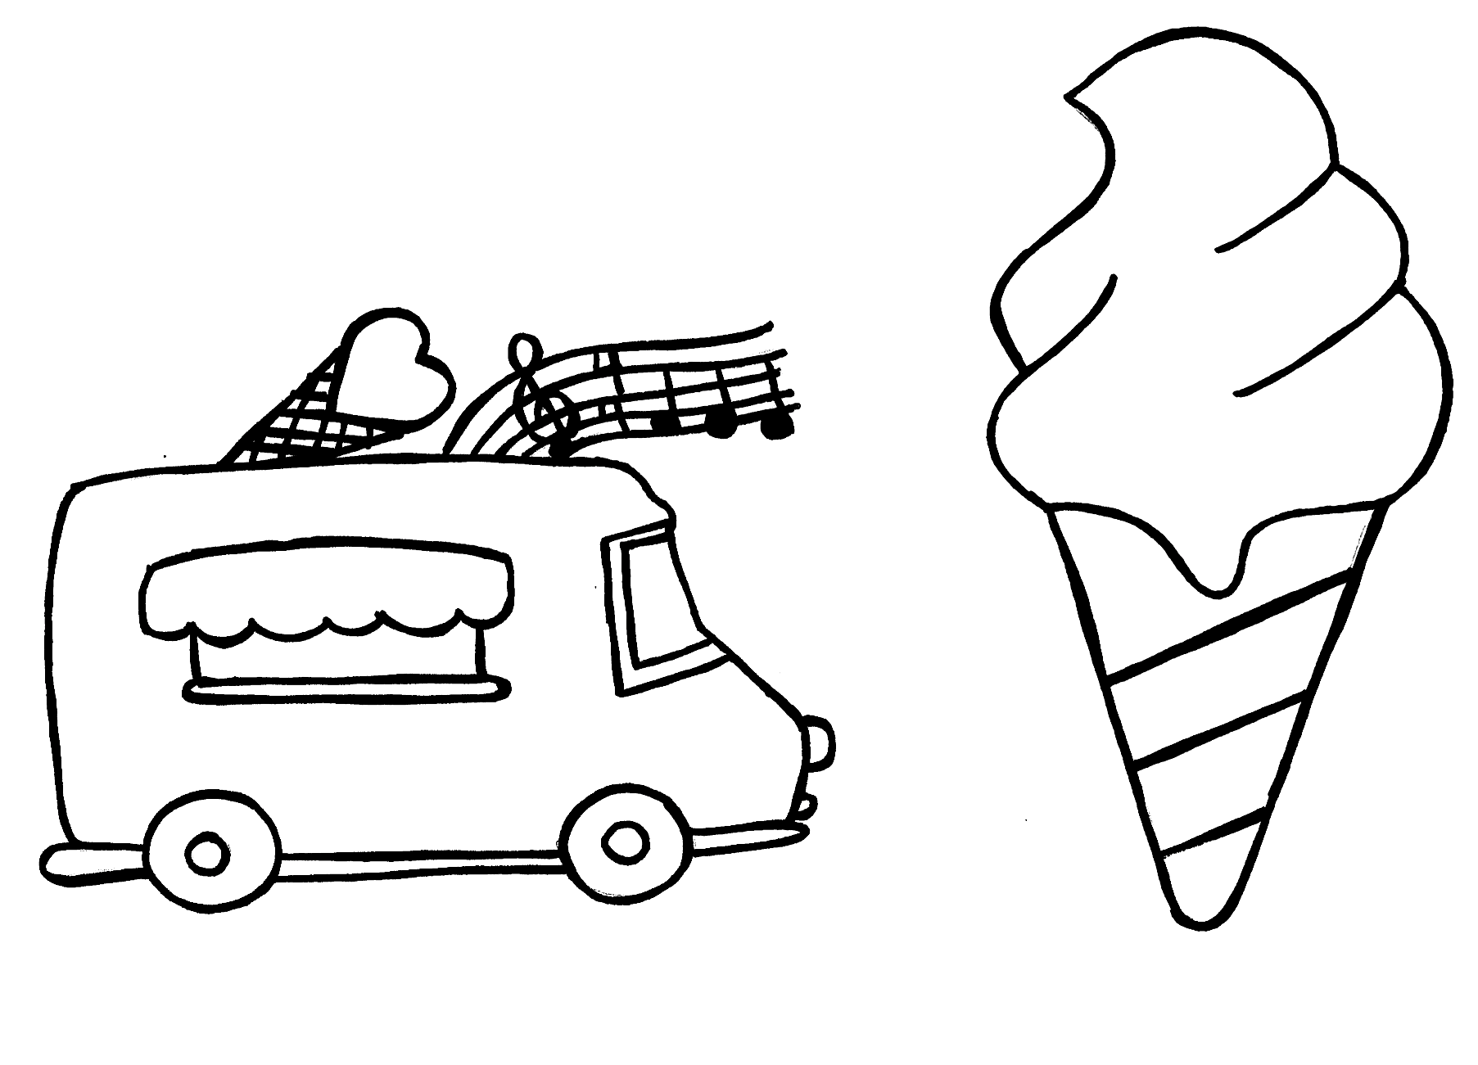
oshâ wâw ________
oraanzh ________
orange ________
Copyright © Rupertsland Institute 2021
Notes:
oshâ wâw (say: oh-shah wahw)
Oraanzh (say: oh-rahn-je)
In Heritage Michif, ‘zh’ make a sound like a soft ‘g’ sound, similar the ’g’ sound when you say ‘orange’

Slide 8
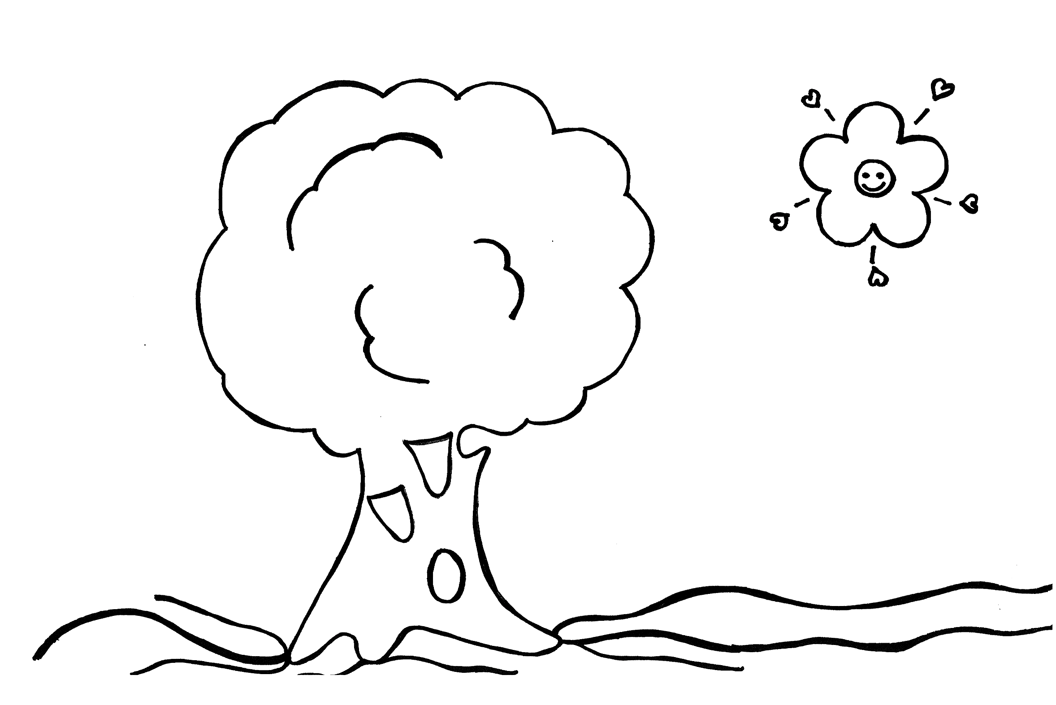
uskêtuk wâw________
ver ________
green ________
Copyright © Rupertsland Institute 2021
Notes:
uskêtuk wâw (say: oo-skay-tuhk wahw)
Ver (say: vair)

Slide 9
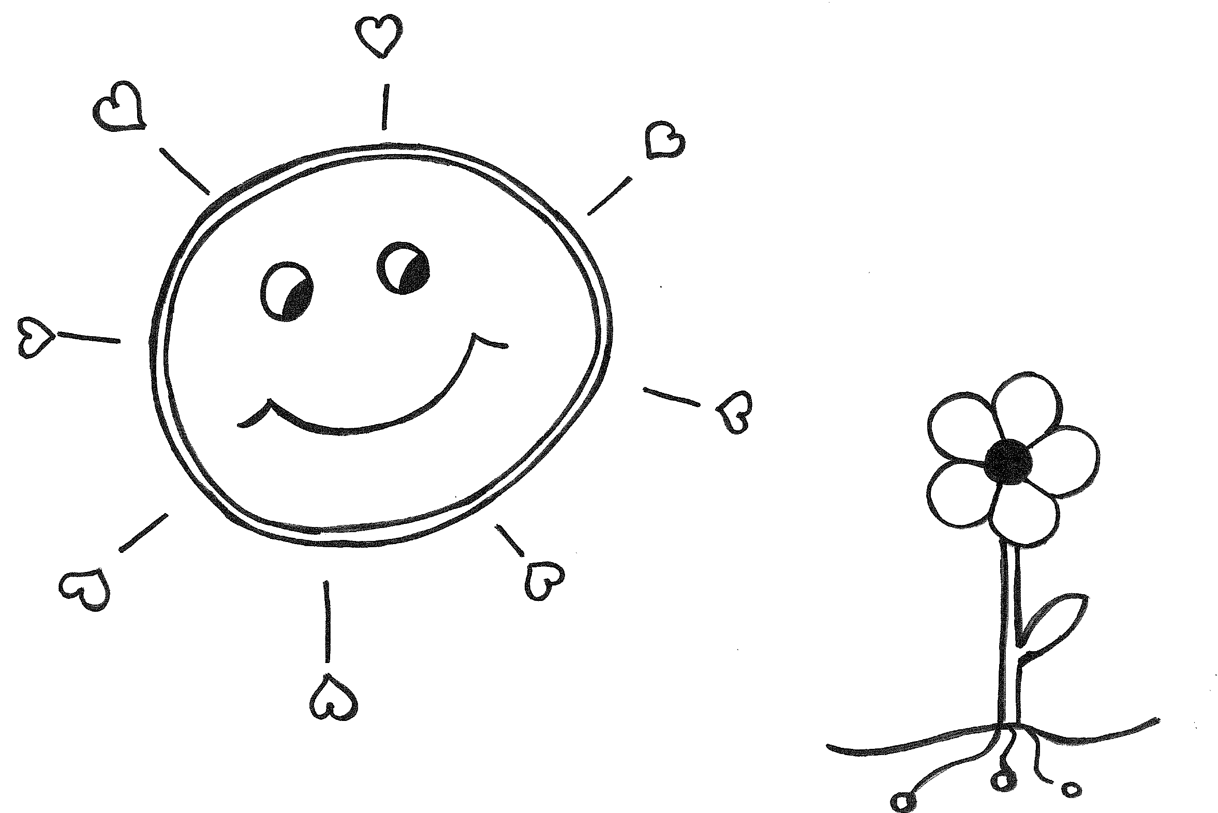
wâpisk wâw ________
zhoon ________
yellow ________
Copyright © Rupertsland Institute 2021
Notes:
wâpisk wâw (say: wah-pisk wahw)
zhoon (joon)
In Heritage Michif, ‘zh’ make a sound like a soft ‘g’ sound, similar the ’g’ sound when you say ‘orange’

Slide 10
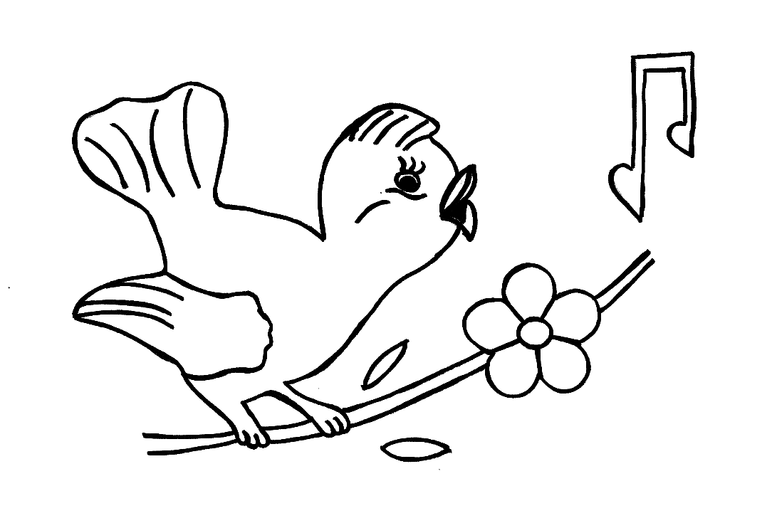
sêpêhk wâw ________
bleu ________
blue ________
Copyright © Rupertsland Institute 2021
Notes:
sêpêhk wâw (say: seh-pehk wahw)
Bleu (say: bluh)

Slide 11
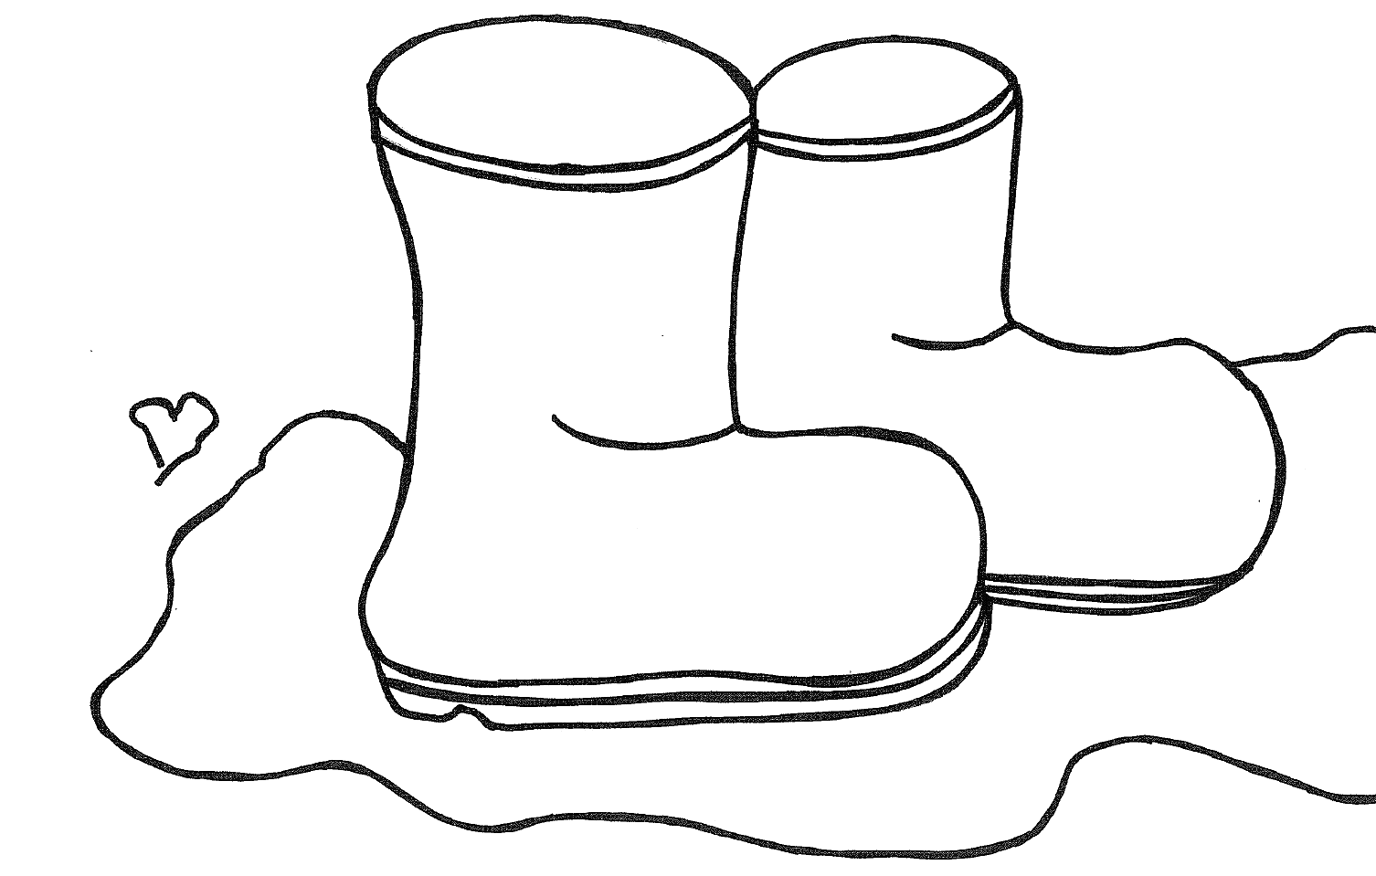
mêhk wâw ________
roozh ________
red ________
Copyright © Rupertsland Institute 2021
Notes:
mêhk wâw (say: meyk wahw)
Roozh (say: roo-je)

Slide 12
Copyright © Rupertsland Institute 2021

